Slide 1
Unit 5 Machine Learning
Lecture 1

Slide 2
What is learning
Learning is the process of acquiring new or modifying existing knowledge, behaviors, skills, values, or preferences
Evidence that learning has occurred may be seen in changes in behavior from simple to complex.

Slide 3
What is Machine Learning?
The machine Learning denotes changes in the systems that are adaptive in the sense that they enable the system to do the same task more effectively the next time.
Like human learning from past experiences, computer system learns from data, which represent some “past experiences” of an application domain.
Therefore, Machine learning gives computers the ability to learn without being explicitly programmed.

Slide 4
Why Machine Learning ?
To learn a target function (relation between input and output)that can be used to predict the values of a discrete class attribute,
– e.g., male or female, and high-risk or low risk, etc.
To model the underlying structure or distribution in the data in order to learn more about the data.
To learns behavior through trial-and-error interactions with a dynamic environment.

Slide 5
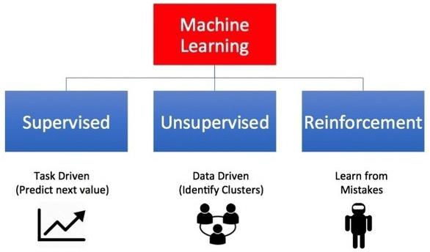
Types
Based on training set machine learning algorithms are classified into the following three categories:

Slide 6
Supervised Learning
Supervised learning is where you have input variables (x) and an output variable (Y) and you use an algorithm to learn the mapping function from the input to the output. Y = f(X)
Learning stops when the algorithm achieves an acceptable level of performance.
when you have new input data (x) that you can predict the output variables (Y) for that data

Slide 7
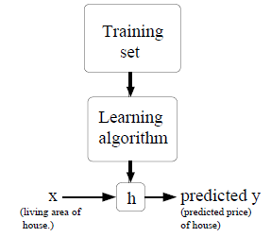
f
Presented By:

Slide 8
Supervised Learning
It is called supervised learning because the process of an algorithm learning from the training dataset can be thought of as a teacher supervising the learning process.
We know the correct answers, the algorithm iteratively makes predictions on the training data and is corrected by the teacher.

Slide 9
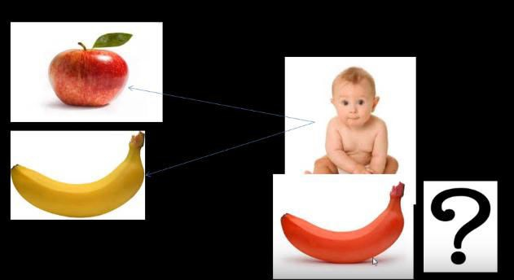
Supervised Learning

Slide 10
Unsupervised Learning
Unsupervised learning is where you only have input data (X) and no corresponding output variables(targets/ labels).
The goal for unsupervised learning is to model the underlying structure or distribution in the data in order to learn more about the data.
These are called unsupervised learning because unlike supervised learning above there is no correct answers and there is no teacher.
Algorithms are left to their own devises to discover and present the interesting structure in the data.
E.g., Clustering

Slide 11

Unsupervised Learning

Slide 12
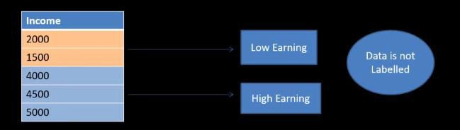
Unsupervised Learning

Slide 13
Reinforcement Learning
Is learning behavior through trial-and-error interactions with a environment.
Is learning how to act in order to maximize a reward (Encouragements).
Reinforcement learning emphasizes learning feedback that evaluates the learner's performance without providing standards of correctness in the form of behavioral targets.
Example: Bicycle learning, game playing, etc.

Slide 14
Supervised Learning Algorithm
Classification:
To predict the outcome of a given sample where the output variable is in the form of categories(discrete). Examples include labels such as, sick and healthy.
Regression:
-To predict the outcome of a given sample where the output variable is in the form of real values(continuous). Examples include real-valued labels denoting the amount of rainfall, the height of a person

Slide 15
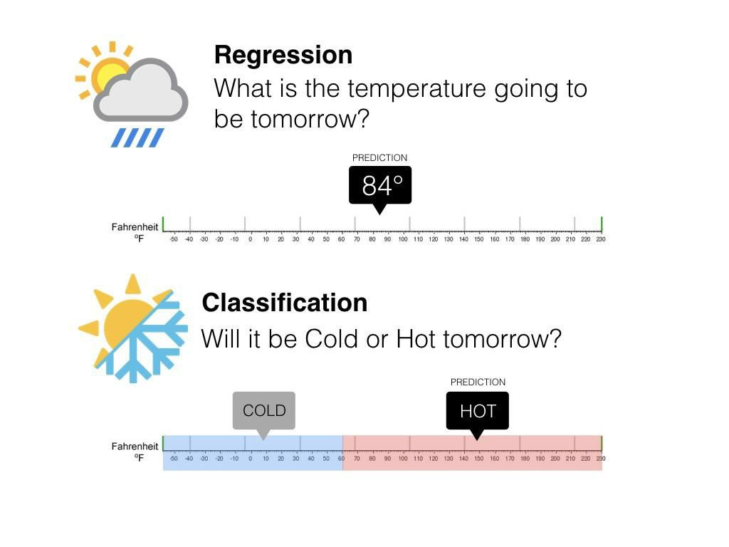
Contd.

Slide 16
Learning by Analogy:
Reasoning by analogy generally involves abstracting details from a particular set of problems and resolving structural similarities between previously distinct problems.
Analogical reasoning refers to this process of recognition and then applying the solution from the known problem to the new problem.
Such a technique is often identified as case- based reasoning. Analogical learning generally involves developing a set of mappings between features of two instances.

Slide 17
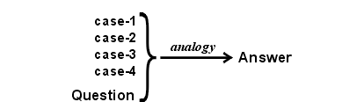

Slide 18
The question in above figure represents some known aspects of a new case, which has unknown aspects to be determined.
In deduction, the known aspects are compared (by a version of structure mapping called unification) with the premises of some implication.
Then the unknown aspects, which answer the question, are derived from the conclusion of the implication.
In analogy, the known aspects of the new case are compared with the corresponding aspects of the older cases.
The case that gives the best match may be assumed as the best source of evidence for estimating the unknown aspects of the new case.
The other cases show alternative possibilities for those unknown aspects; the closer the agreement among the alternatives, the stronger the evidence for the conclusion

Slide 19
Retrieve:
Given a target problem, retrieve cases from memory that are relevant to solving it.
A case consists of a problem, its solution, and, typically, annotations about how the solution was derived. For example, suppose Fred wants to prepare blueberry pancakes.
The procedure he followed for making the plain pancakes, together with justifications for decisions made along the way, constitutes Fred's retrieved case.

Slide 20
2. Reuse:
Map the solution from the previous case to the target problem.
This may involve adapting the solution as needed to fit the new situation.
In the pancake example, Fred must adapt his retrieved solution to include the addition of blueberries.

Slide 21
3. Revise:
Having mapped the previous solution to the target situation, test the new solution in the real world (or a simulation) and, if necessary, revise.
Suppose Fred adapted his pancake solution by adding blueberries to the batter.
After mixing, he discovers that the batter has turned blue – an undesired effect.
This suggests the following revision: delay the addition of blueberries until after the batter has been ladled into the pan.

Slide 22
4. Retain:
After the solution has been successfully adapted to the target problem, store the resulting experience as a new case in memory.
Fred, accordingly, records his newfound procedure for making blueberry pancakes, thereby enriching his set of stored experiences, and better preparing him for future pancake-making demands.

Slide 23
Transformational Analogy:
Suppose you are asked to prove a theorem in plane geometry.
You might look for a previous theorem that is very similar and copy its proof, making substitutions when necessary.
The idea is to transform a solution to a previous problem in to solution for the current problem. The following figure shows this process,

Slide 24
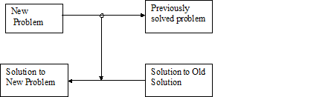
Fig: Transformational Analogy

Slide 25
Derivational Analogy:
Notice that transformational analogy does not look at how the old problem was solved, it only looks at the final solution.
Often the twists and turns involved in solving an old problem are relevant to solving a new problem.
The detailed history of problem solving episode is called derivation, Analogical reasoning that takes these histories into account is called derivational analogy.

Slide 26
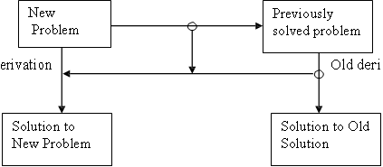
New d
vation
Fig: Derivational Analogy

Slide 27
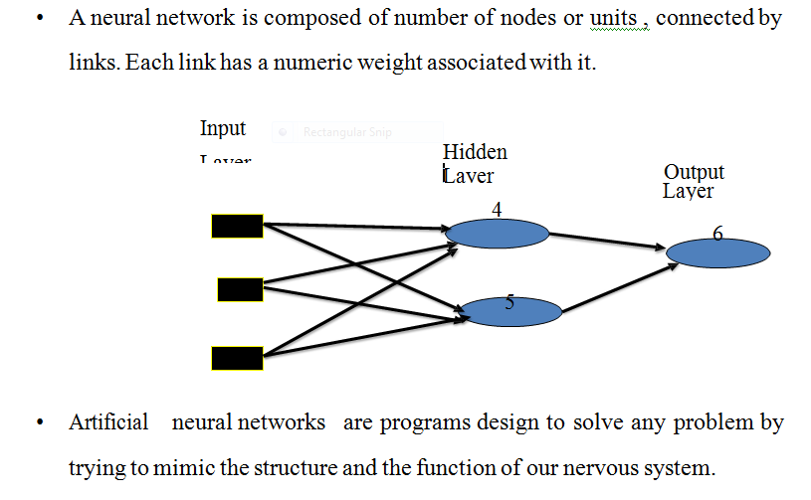
Artificial Neural Networks

Slide 28
Artificial neural network model:
Input to the network are represented by mathematical symbol xn.
Each of these inputs are multiplied by a connection weight, wn
sum =w1 x1 +w2 x2+...... + wn xn
These products are simply summed, fed through the transfer function f() to generate result and output

Slide 29
Back Propagation Algorithm
Back propagation is the essence of neural network training.
It is the method of fine-tuning the weights of a neural network based on the error rate obtained in the previous iteration.
Proper tuning of the weights allows to reduce error rates and make the model reliable by increasing its generalization.
Backpropagation in neural network is a short form for “backward propagation of errors.”
It is a standard method of training artificial neural networks.
This method helps calculate the gradient of a loss function with respect to all the weights in the network.

Slide 30
How Back Propagation Algorithm Works?
The Back propagation algorithm in neural network computes the gradient of the loss function for a single weight by the chain rule.
It efficiently computes one layer at a time, unlike a native direct computation.
It computes the gradient, but it does not define how the gradient is used.
It generalizes the computation in the delta rule.
Consider the following Back propagation neural network example diagram to understand:

Slide 31
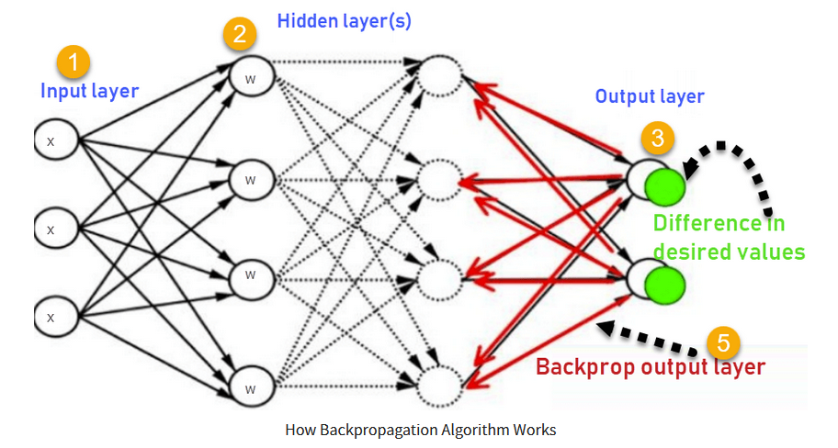

Slide 32
Inputs X, arrive through the pre connected path
Input is modeled using real weights W. The weights are usually randomly selected.
Calculate the output for every neuron from the input layer, to the hidden layers, to the output layer.
Calculate the error in the outputs
Error_{B}= Actual Output – Desired Output
Travel back from the output layer to the hidden layer to adjust the weights such that the error is decreased.
Keep repeating the process until the desired output is achieved

Slide 33
Why We Need Backpropagation?
Most prominent advantages of Backpropagation are:
Back propagation is fast, simple and easy to program
It has no parameters to tune apart from the numbers of input
It is a flexible method as it does not require prior knowledge about the network
It is a standard method that generally works well
It does not need any special mention of the features of the function to be learned.

Slide 34
Learning in Neural Networks:
Learning:
Learning in neural networks is carried out by adjusting the connection weights among neurons.
There is no algorithm that determines how the weights should be assigned in order to solve specific problems. Hence, the weights are determined by a learning process
Learning may be classified into two categories:
Supervised Learning
Unsupervised Learning

Slide 35
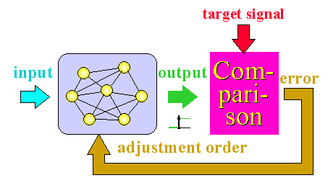
Learning in Neural Networks:
1) Supervised Learning:
In supervised learning, the network is presented with inputs together with the target (teacher signal) outputs.
Then, the neural network tries to produce an output as close as possible to the target output by adjusting the values of internal weights.
The most common supervised learning method is the “error correction method”.
Neural networks are trained with this method in order to reduce the error (difference between the network's output and the desired output) to zero.

Slide 36
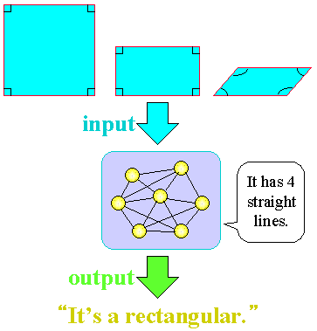
Learning in Neural Networks:
2) Unsupervised Learning:
In unsupervised learning, there is no teacher (target signal/output) from outside and the network adjusts its weights in response to only the input patterns
A typical example of unsupervised learning is Hebbian learning.

Slide 37
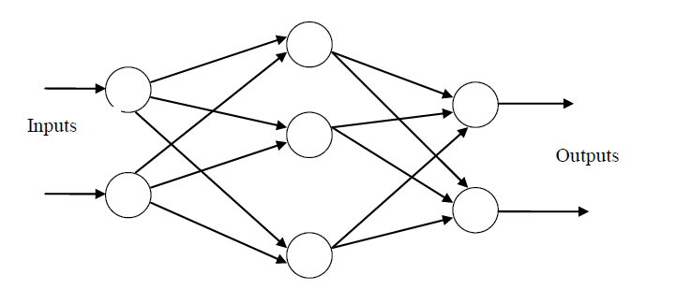
Network Architecture
Feed-forward networks:
Feed-forward ANNs allow signals to travel one way only; from input to output.
Feed-forward ANNs tend to be straight forward networks that associate inputs with outputs.

Slide 38
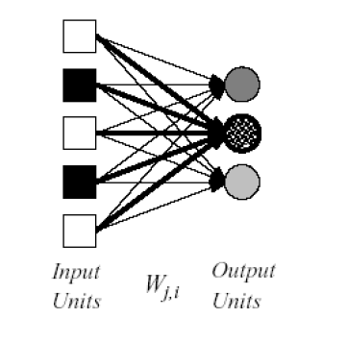
Types of Feed Forward Neural Network:
a) Single-layer neural networks
A neural network in which all the inputs connected directly to the outputs is called a single-layer neural network.

Slide 39
Types of Feed Forward Neural Network:
Single-layer Feed Forward neural networks :
Two types:
Perceptron, and
ADLINE

Slide 40
Perceptron
Developed by Frank Rosenblatt by using McCulloch and Pitts model, perceptron is the basic operational unit of artificial neural networks.
It employs supervised learning rule and is able to classify the data into two classes.
Operational characteristics of the perceptron:
It consists of a single neuron with an arbitrary number of inputs along with adjustable weights, but the output of the neuron is 1 or -1 depending upon the input. It also consists of a bias whose weight is always 1.
Following figure gives a schematic representation of the perceptron.

Slide 41
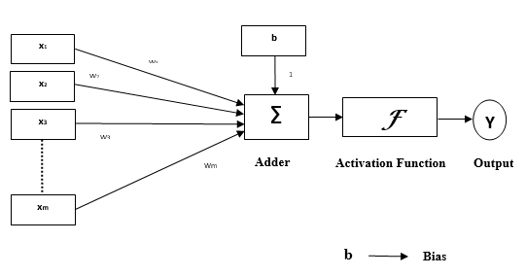
Perceptron
Following figure gives a schematic representation of the perceptron:

Slide 42
Perceptron
Perceptron thus has the following three basic elements:
Links
Adder
Activation function

Slide 43
Adaptive Linear Neuron (ADALINE)
ADALINE which stands for Adaptive Linear Neuron, is a network having a single linear unit.
It was developed by Widrow and Hoff in 1960. Some important points about ADALINE are as follows:
It uses bipolar activation function.
It uses delta rule for training to minimize the Mean-Squared Error (MSE) between the actual output and the desired/target output.
The weights and the bias are adjustable.

Slide 44
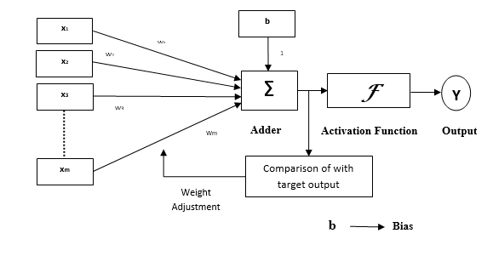
Adaptive Linear Neuron (ADALINE)
Architecture :
The basic structure of ADALINE is similar to perceptron having an extra feedback loop with the help of which the calculated output is compared with the desired/target output.
After comparison on the basis of training algorithm, the weights and bias will be updated.

Slide 45
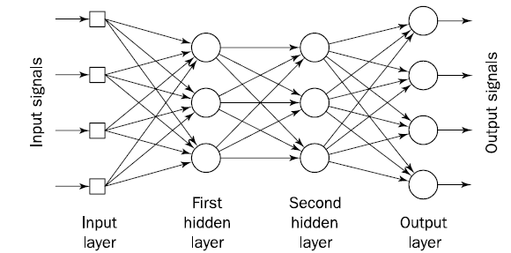
Types of Feed Forward Neural Network:
b) Multilayer neural networks
The neural network which contains input layers, output layers and some hidden layers also is called multilayer neural network.

Slide 46
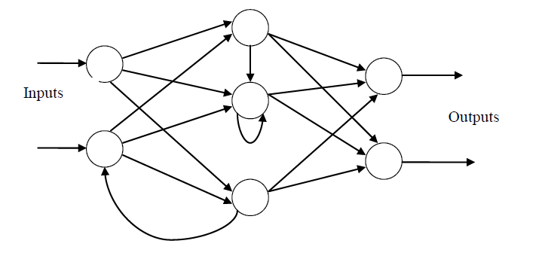
Network Architectures
2) Feedback networks (Recurrent networks:)
Feedback networks can have signals traveling in both directions by introducing loops in the network.
very powerful
extremely complicated.
dynamic: Their 'state' is changing continuously until they reach an equilibrium point.
also known as interactive or recurrent.

Slide 47
Loss Function:
The loss function (also called cost function or objective function) quantifies the difference between the predicted output of the neural network and the actual target (ground truth) values.
During training, the goal of the neural network is to minimize this loss by adjusting its parameters (weights and biases).

Slide 48
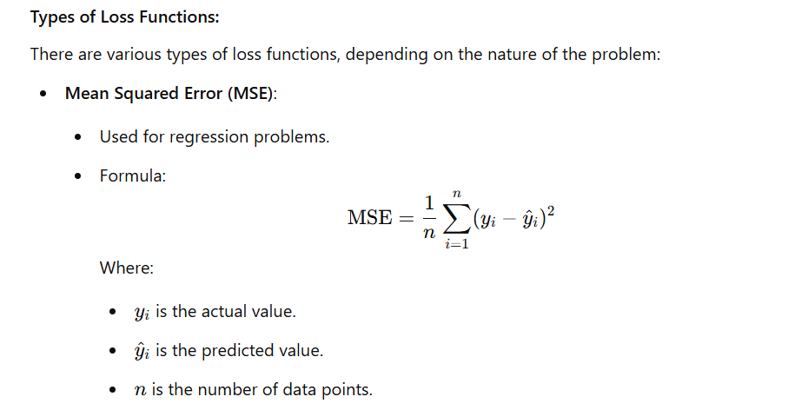

Slide 49
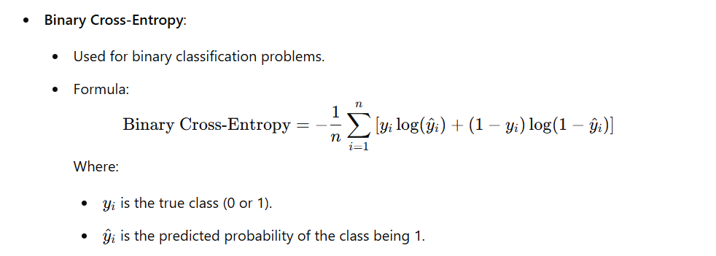

Slide 50
Learning Rate:
The learning rate is a hyperparameter that determines the size of the steps the model takes when updating its weights based on the gradient of the loss function.
Key Points about Learning Rate:
It controls how quickly or slowly the neural network learns.
A high learning rate might cause the model to converge too quickly, skipping over the optimal solution and possibly leading to poor performance.
A low learning rate can lead to a more stable learning process, but it can also result in slow convergence or getting stuck in a local minimum.

Slide 51
Types of Learning Rate Scheduling:
Constant Learning Rate: The learning rate remains fixed throughout training.
Decay: The learning rate decreases over time (e.g., step decay, exponential decay) to allow the model to converge more precisely in later stages.
Adaptive Learning Rates: Algorithms like Adam, Adagrad, and RMSProp adjust the learning rate dynamically for each parameter, helping to converge faster.

Slide 52
Choosing an Optimal Learning Rate:
Too large: Can cause the model to overshoot and fail to converge.
Too small: Can make training slow, requiring more epochs to converge.
A good practice is to use techniques like learning rate schedules or learning rate warm-up (gradually increasing the learning rate in the early stages) to get better results.

Slide 53
Applications of Neural Network
Speech recognition
Optical character recognition
Face Recognition
Pronunciation (NETtalk)
Stock-market prediction
Navigation of a car
Signal processing/Communication
Imaging/Vision
….

